Slide 1
Computer Graphics III – Approximate global illumination computation
Jaroslav Křivánek, MFF UK
Jaroslav.Krivanek@mff.cuni.cz

Slide 2
Review

Slide 3
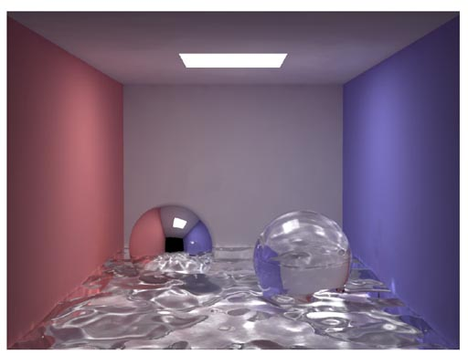
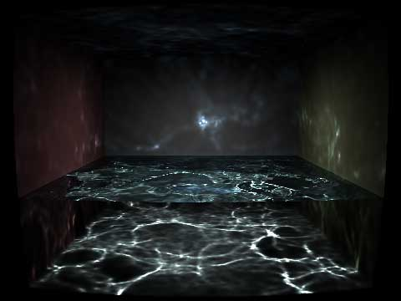
Photon mapping – SDS paths
© H.W.Jensen
© Wojciech Jarosz

Slide 4
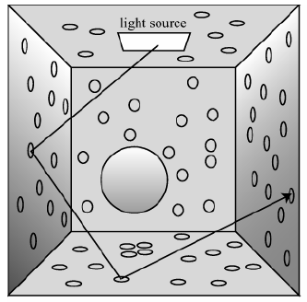
Photon mapping – Steps
Photon tracing
Rendering with photon maps

Slide 5
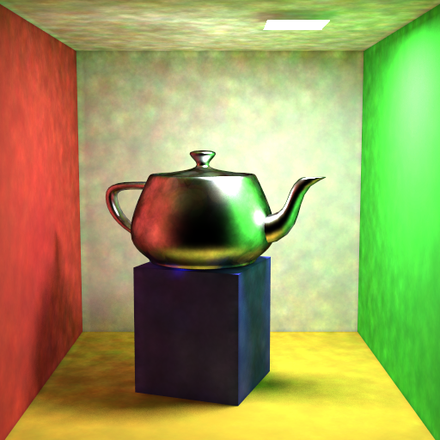
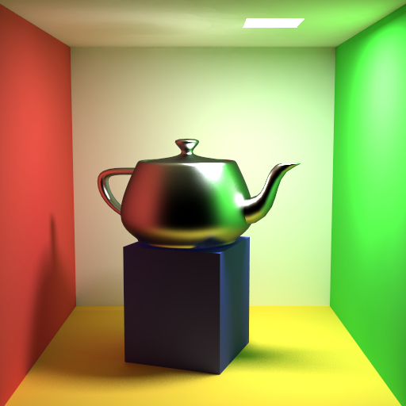

Final gathering?
direct use
final gathering
500 – 5000 rays
information in the global photon map too inaccurate
inaccuracy in the global maps gets “averaged out”

Slide 6
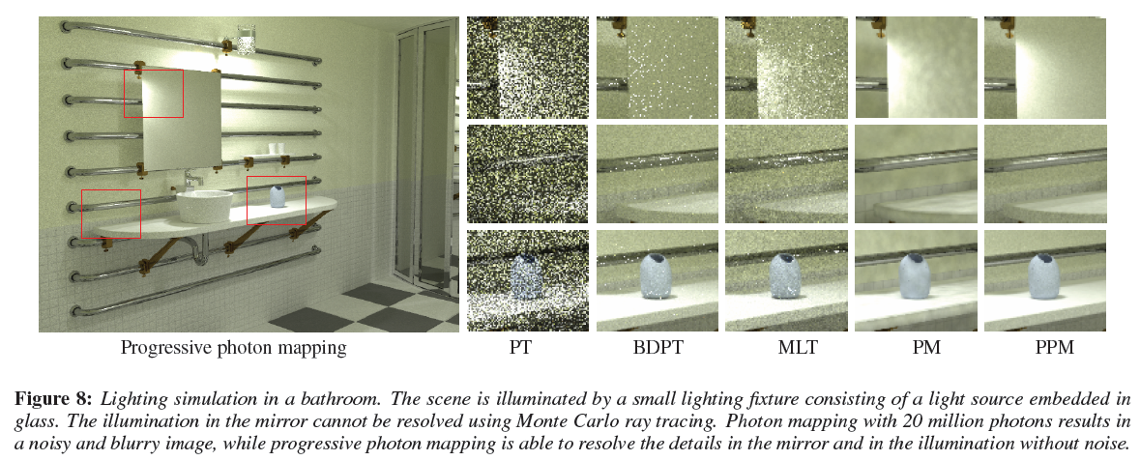
Progressive photon mapping

Slide 7
Approximate GI methods

Slide 8
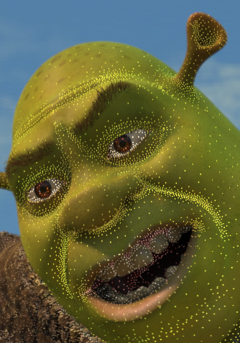

Irradiance caching
Jaroslav Křivánek
Charles University, Prague
Jaroslav.Krivanek@mff.cuni.cz

Slide 9
Motivation
Distribution path tracing (DPT) Final gathering (FG)
Estimate illumination integral at a point by tracing many rays (500-5000)
Costly computation
Irradiance caching accelerates DPT/FG for diffuse indirect illumination

Slide 10
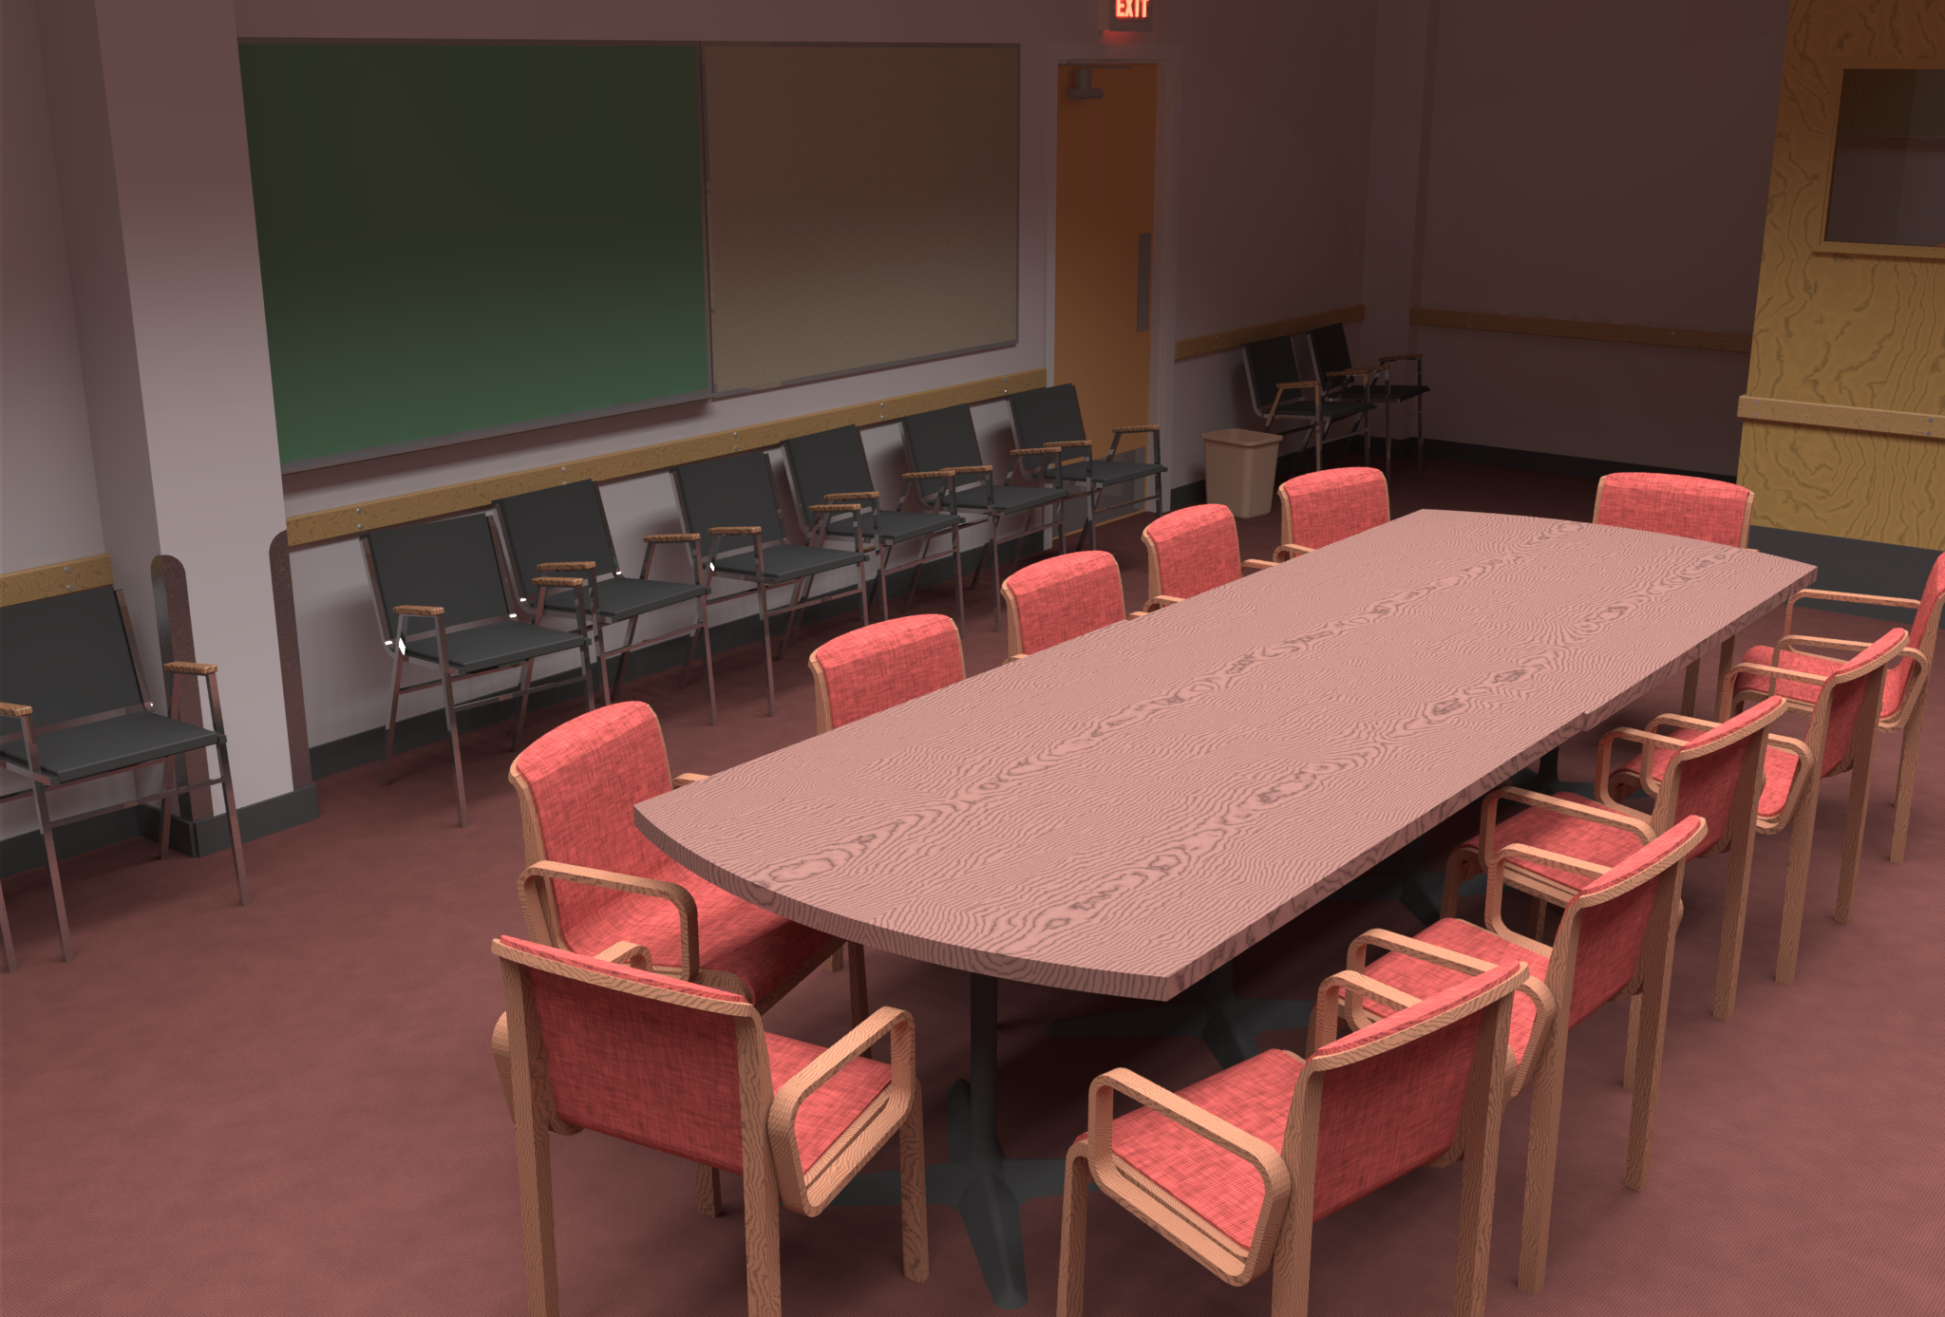
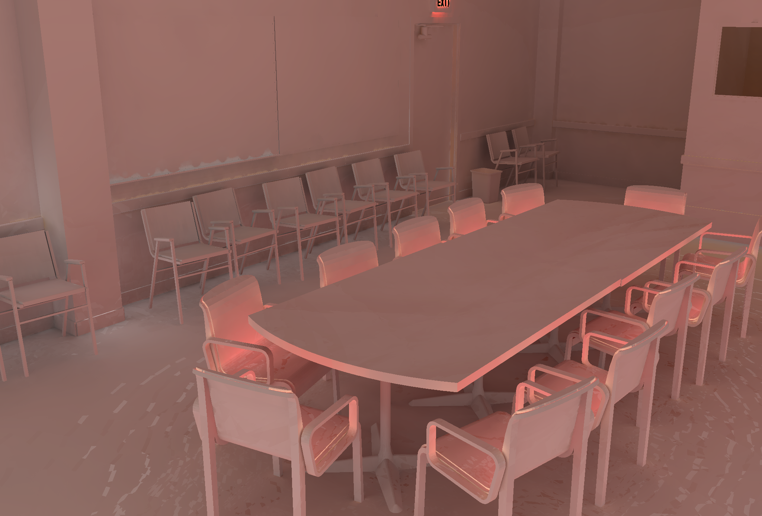
Motivation
Spatial coherence
Diffuse indirect illumination changes slowly over surfaces
Indirect irradiance – changes slowly

Slide 11
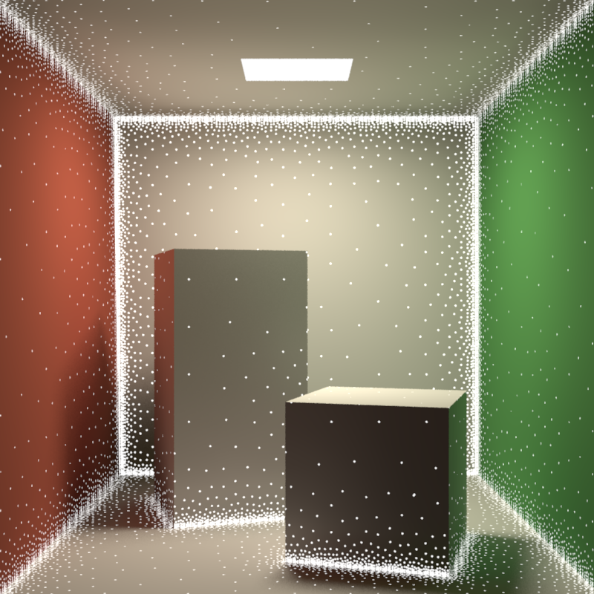
Irradiance caching
Sparse locations for full DRT computation
Resulting irradiance stored in a cache
Most pixels interpolated from cached records
Image credit: Okan Arikan

Slide 12
Irradiance caching
Faster computation of the diffuse component of indirect illumination
Diffuse reflection
L_{o}(p) = E(p) * ρ_{d}(p) / π
View-independence
Outgoing radiance independent of view direction
Total irradiance is all we need => cache irradiance

Slide 13
Irradiance caching
Lazy evaluation of new irradiance values
Only if cannot be interpolated from existing ones
Example: Values E1 and E2 already stored
Interpolate at A (fast)
Extrapolate at B (fast)
Add new record at C (slow)
B
E2
A
E1
C → E3

Slide 14
Irradiance caching pseudocode
GetIrradiance(p):
Color E = InterpolateFromCache(p);
if( E == invalid )
E = SampleHemisphere(p);
InsertIntoCache(E, p);
return E;

Slide 15
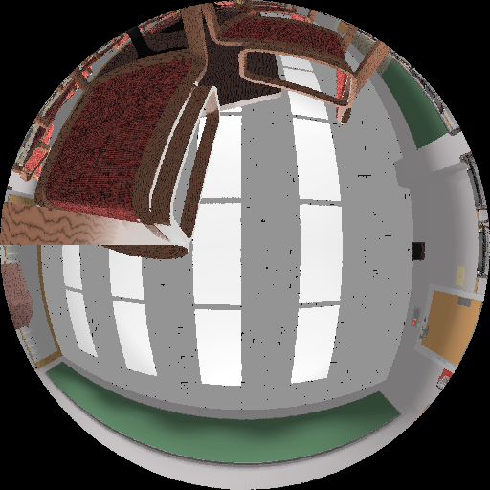
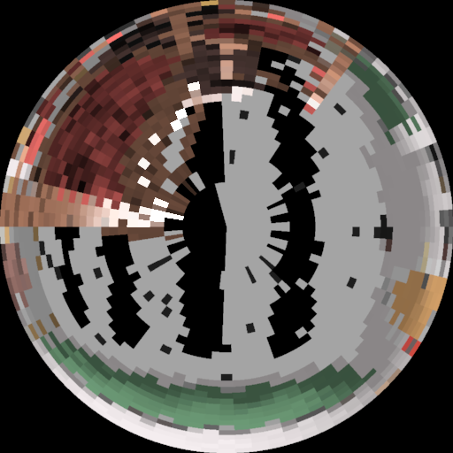
Indirect irradiance calculation
E = SampleHemisphere(p);
Cast 500-5000 secondary rays (user-specified)
Compute illumination at intersection
Direct illumination only, or
Path tracing, or
Photon map radiance estimate, or
Query in (another) irradiance cache
No emission taken into account!

Slide 16
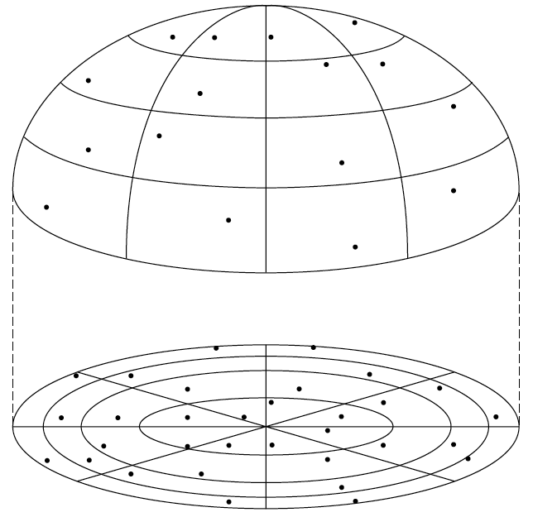
Indirect irradiance calculation
E = SampleHemisphere(p);
Stratified Monte Carlo hemisphere sampling
Subdivide hemisphere into cells
Choose a random direction in each cell and trace ray

Slide 17
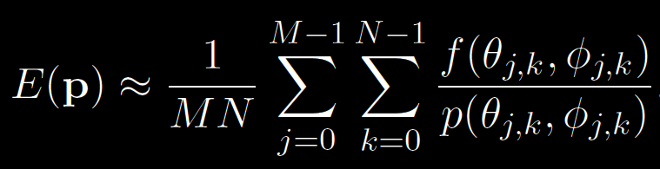
Indirect irradiance calculation
E = SampleHemisphere(p);
Estimating irradiance at p:
General form of the stratified estimator
E(p) = ∫ L_{i}(p, ω_{i}) cosθ_{i} dω_{i}

Slide 18
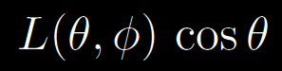
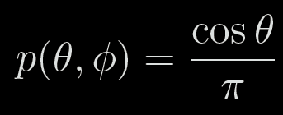
Indirect irradiance calculation
E = SampleHemisphere(p);
For irradiance calculation, the integrand is:
PDF:

Slide 19
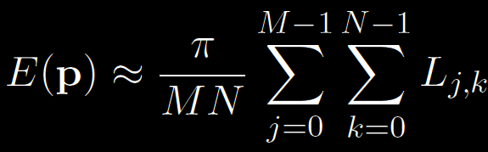
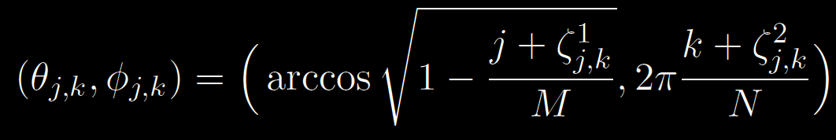
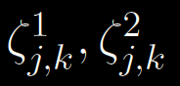
Indirect irradiance calculation
Irradiance estimator for IC:
L_{j,k} … radiance sample from direction:
M, N … number of divisions along θ and φ
… random numbers from R(0,1)

Slide 20
Irradiance caching pseudocode
GetIrradiance(p):
Color E = InterpolateFromCache(p);
if( E == invalid )
E = SampleHemisphere(p);
InsertIntoCache(E, p);
return E;

Slide 21
Record spacing
If E(p) changes slowly => interpolate more
If E(p) changes quickly => interpolate less
What is the upper bound on rate of change (i.e. gradient) of irradiance?
Answer from the “worst case” analysis (omitted)

Slide 22
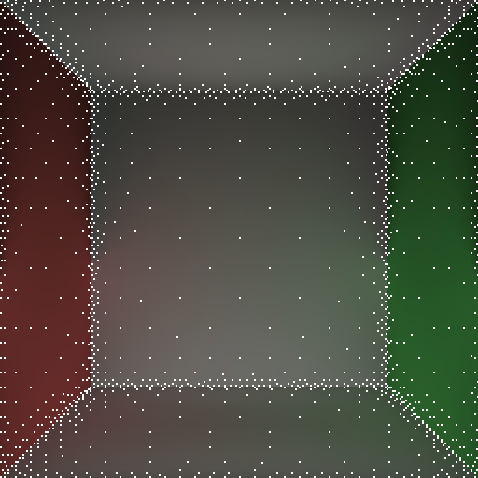
Record spacing
Near geometry → dense spacing
Geometry = source of indirect illumination
Open spaces → sparse sampling

Slide 23
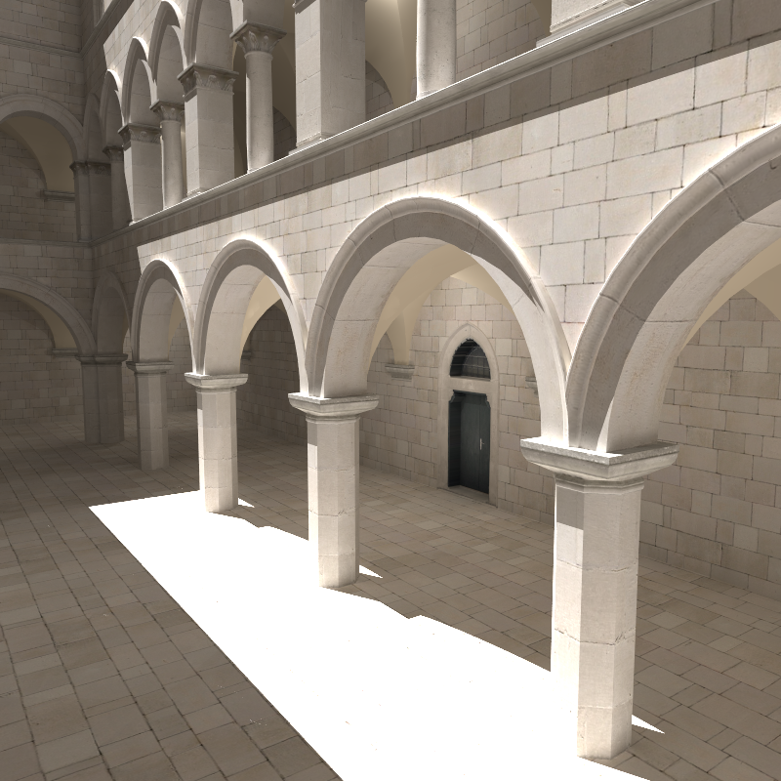
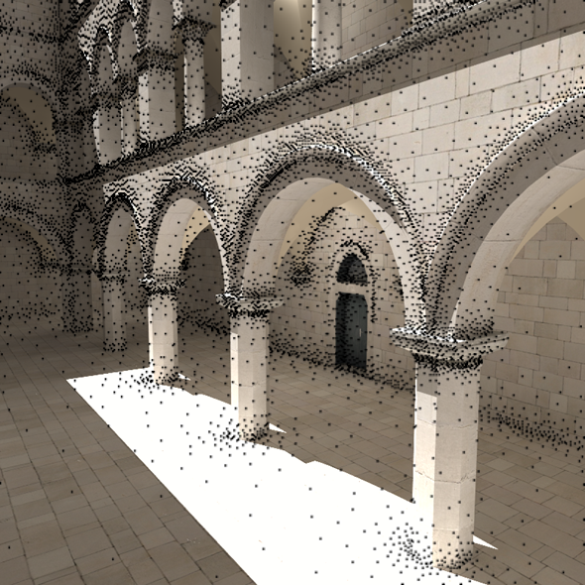
Record spacing

Slide 24
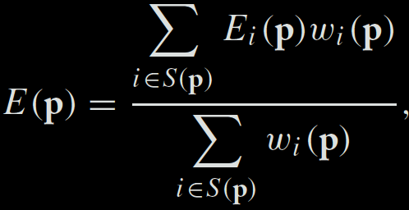
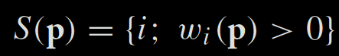
Irradiance interpolation
E = InterpolateFromCache(p)
Weighted average:
Records used for interpolation:

Slide 25
Weighting function
[Tablellion and Lamorlette 04]
p_{i}
R_{i}

Slide 26
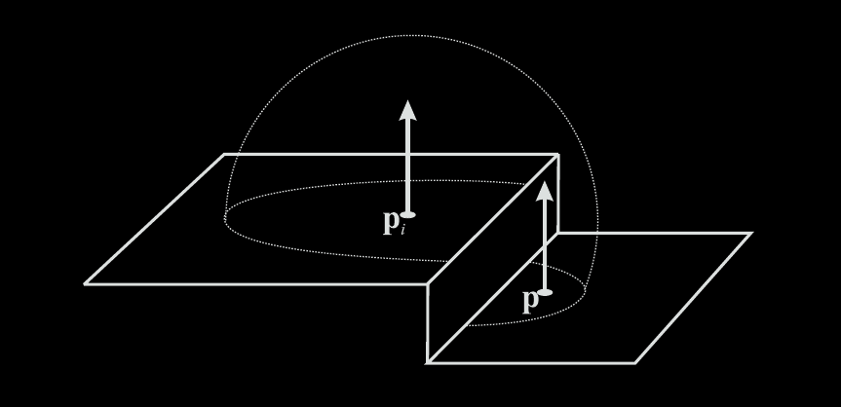
Heuristic “behind” test
Record at p_{i} rejected from interpolation at p if p is “behind” p_{i}

Slide 27
Irradiance caching pseudocode
GetIrradiance(p):
Color E = InterpolateFromCache(p);
if( E == invalid )
E = SampleHemisphere(p);
InsertIntoCache(E, p);
return E;

Slide 28
Irradiance cache record
InsertIntoCache(E, p);
Vector3 position
Vector3 normal
float R
Color E
Color dEdP[3]
Color dEdN[3]
Position in space
Normal at `position’
Validity radius
Stored irradiance
Gradient w.r.t. translation
Gradient w.r.t. rotation

Slide 29
Irradiance cache data structure
InsertIntoCache(E, p);
Requirements
Fast incremental updates (records stored on the fly)
Fast query for all records (spheres) overlapping a given point p

Slide 30
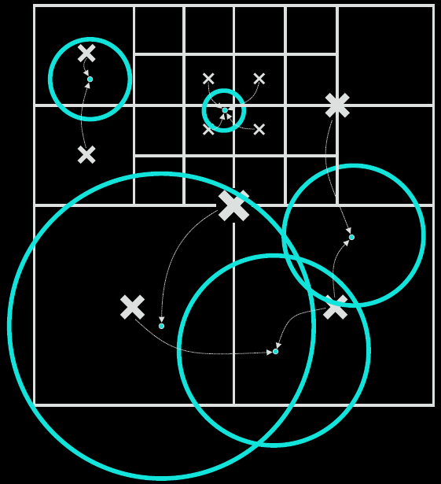
Data structure: Octree
InsertIntoCache(E, p);

Slide 31
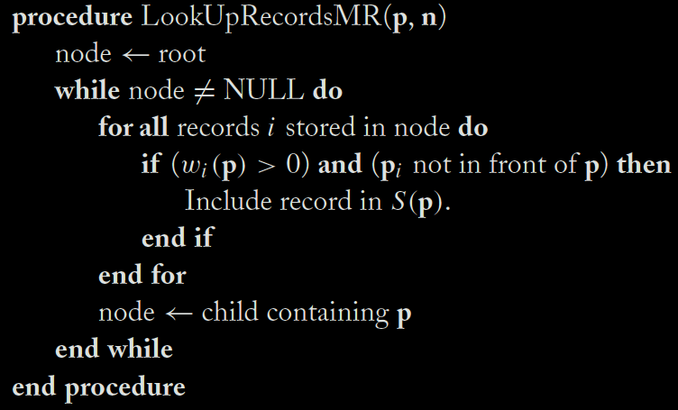
Data structure: Octree
back to … E = InterpolateFromCache(p)

Slide 32
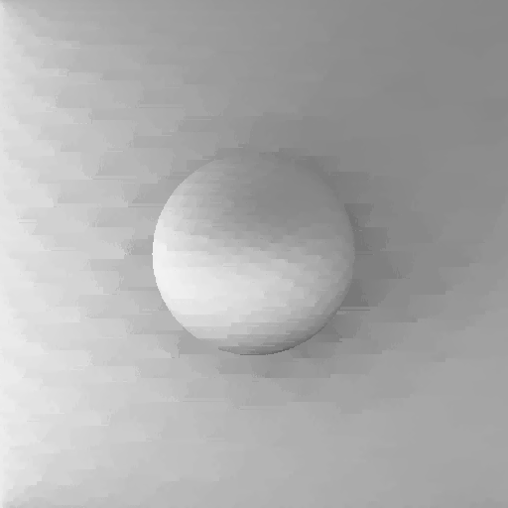
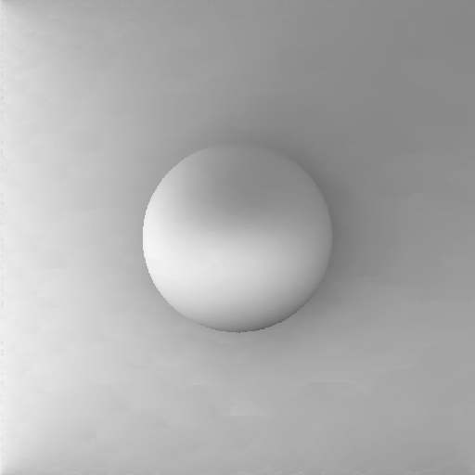
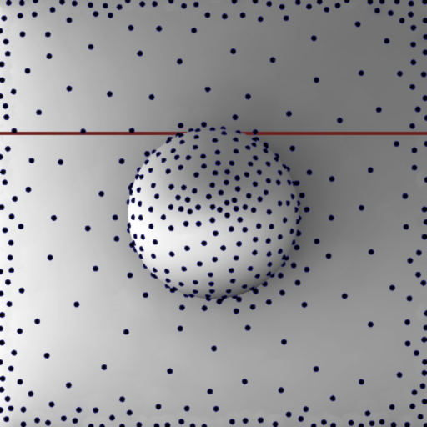
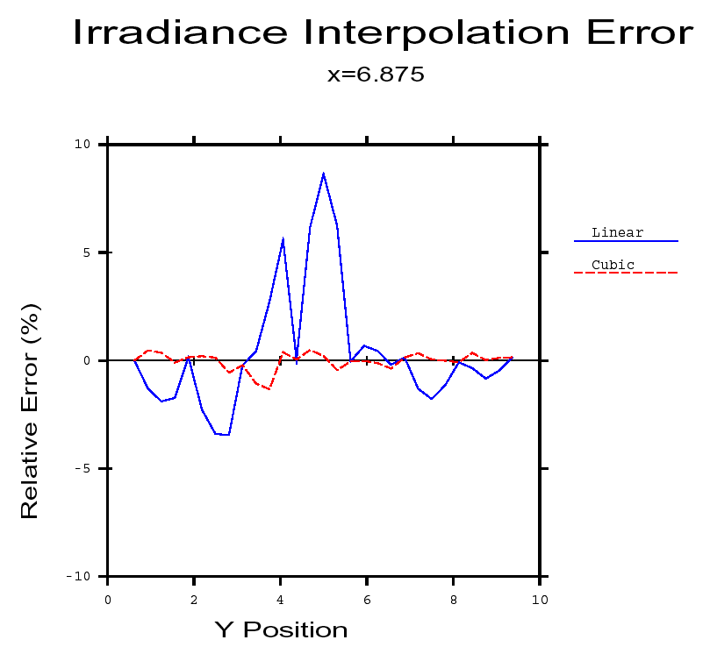
Irradiance gradients
no gradients
with gradients

Slide 33
Irradiance gradients
Essential for smooth interpolation
Calculated during hemisphere sampling
i.e. no extra rays, little overhead
Stored as a part of the record in the cache
Used in interpolation

Slide 34
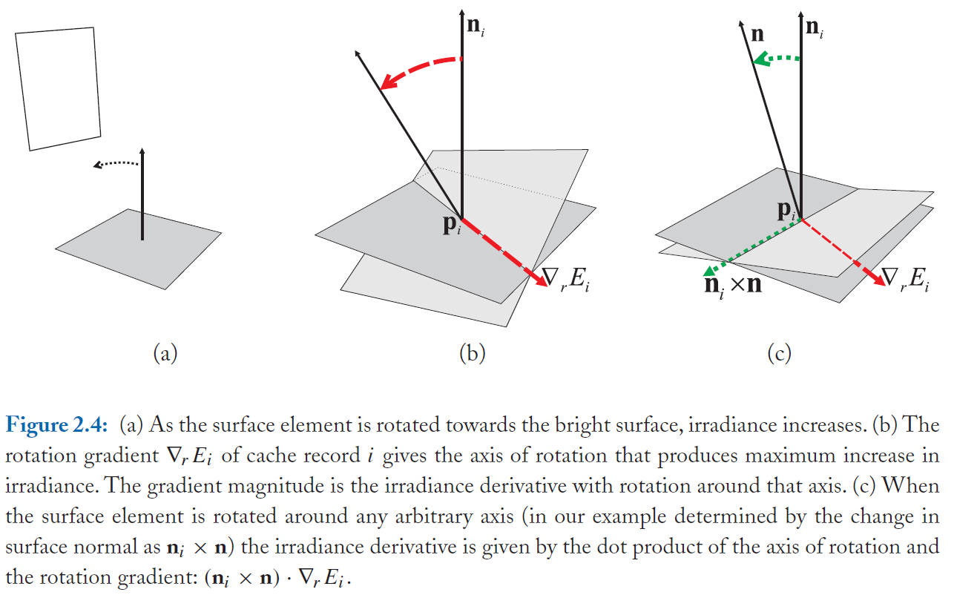
Rotation gradient

Slide 35
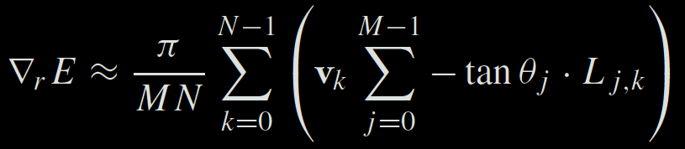
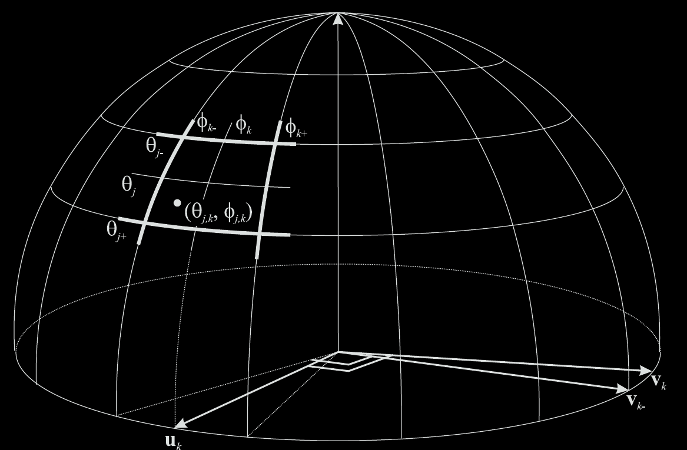
Rotation gradient formula

Slide 36
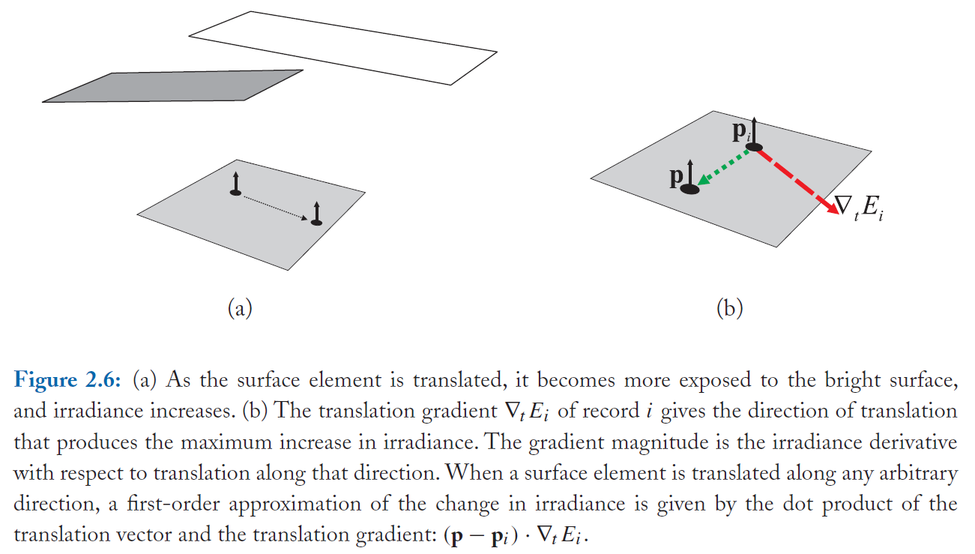
Translation gradient

Slide 37
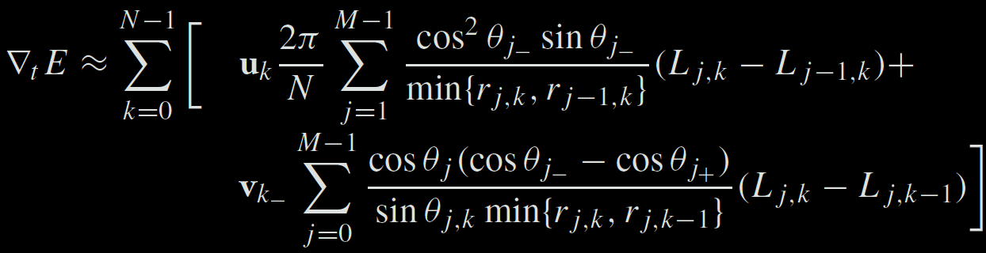
Translation gradient formula
Notes:
To evaluate the translational gradients efficiently and comfortably, it is beneficial to first shoot rays for all hemisphere cell and record the incoming radiance L_{j,k} and the hit distance r_{j,k} in a 2-D table indexed by j and k. With such a table it is then easy to evaluate the sums above.

Slide 38
Irradiance interpolation w/ grads
E = InterpolateFromCache(p)
Weighted average:

Slide 39
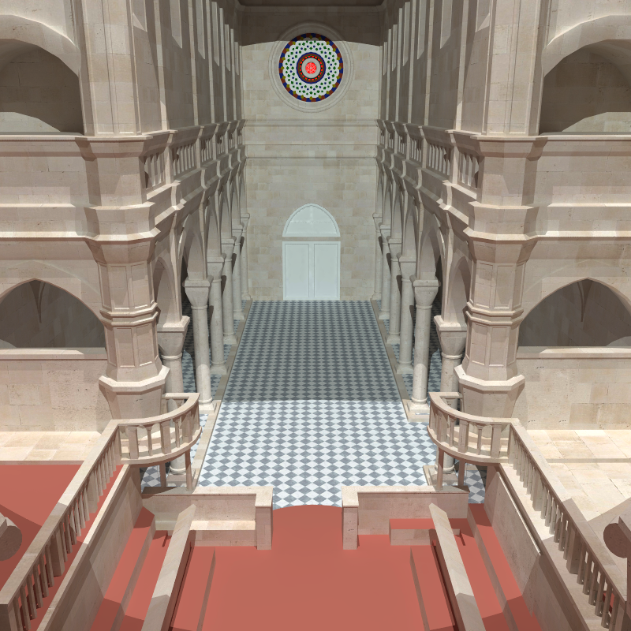
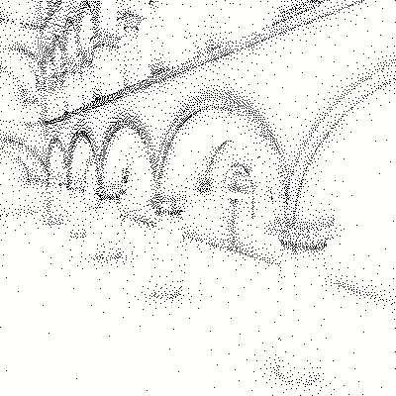
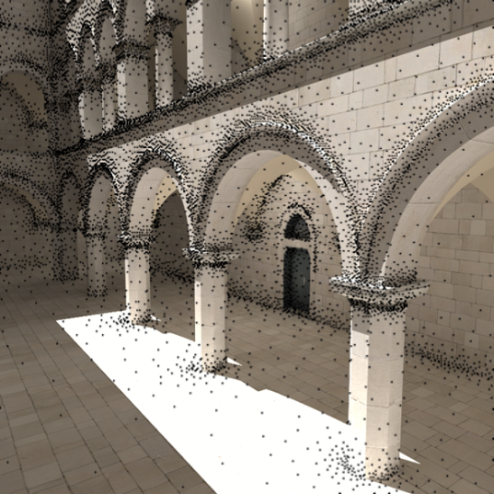
Irradiance caching examples

Slide 40
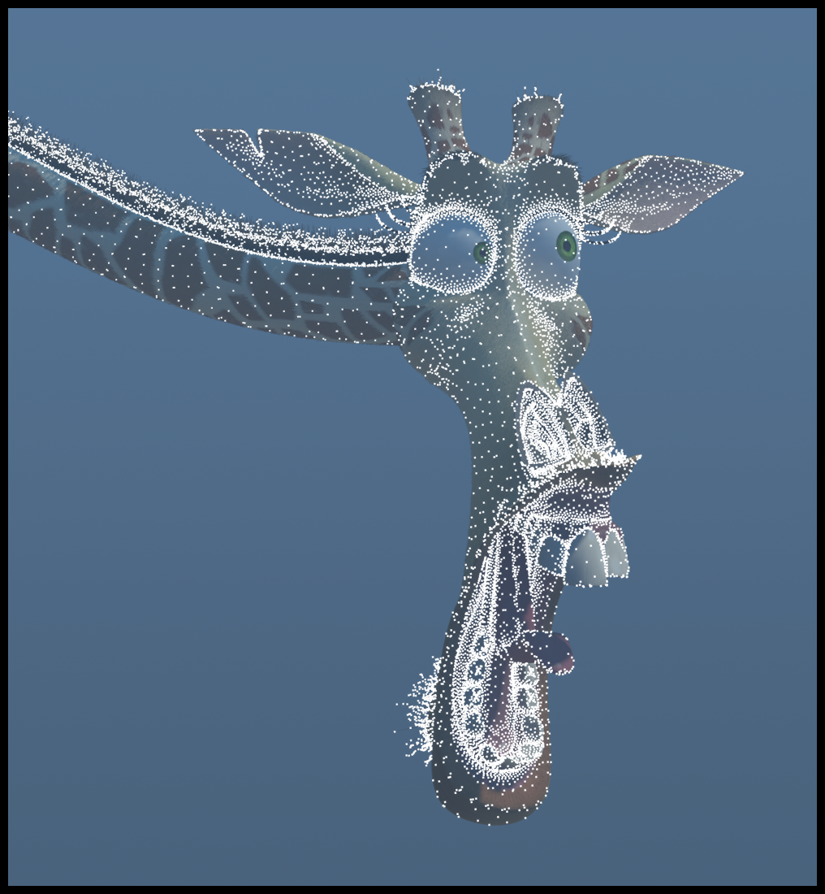
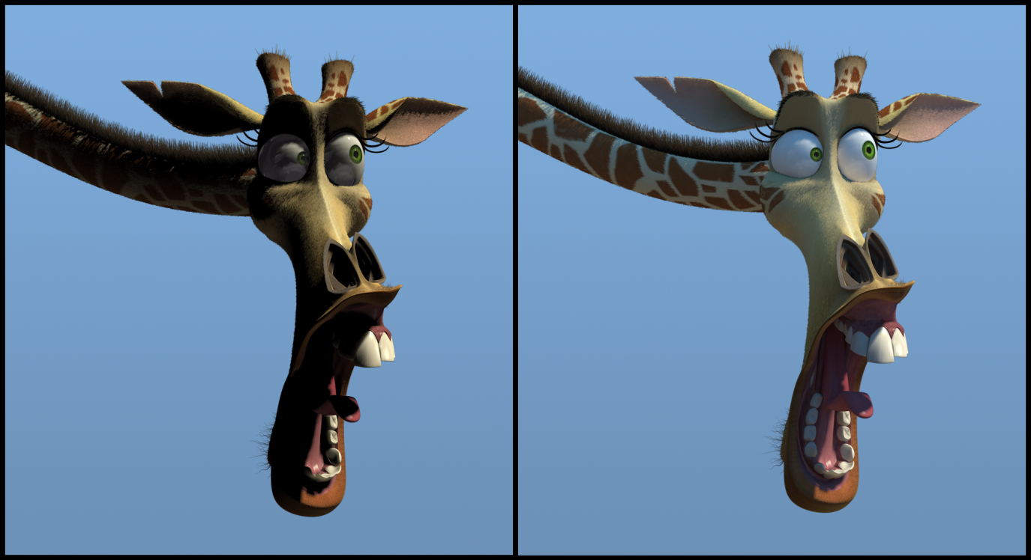
Irradiance caching examples
Image credit: Eric Tabellion, PDI DreamWorks

Slide 41
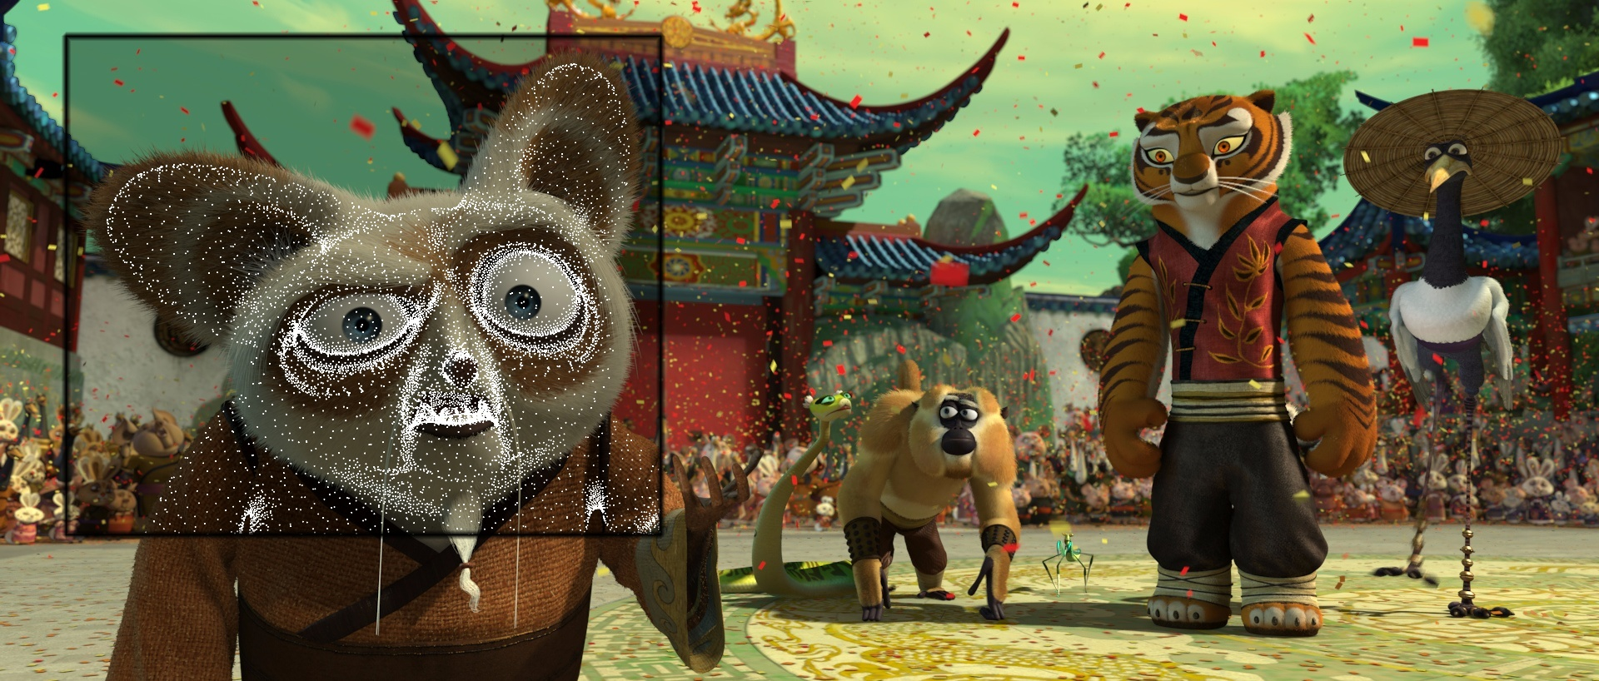
Irradiance caching examples
Image credit: Eric Tabellion, PDI DreamWorks

Slide 42
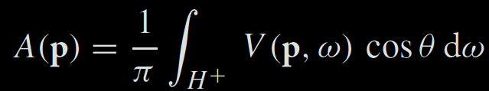
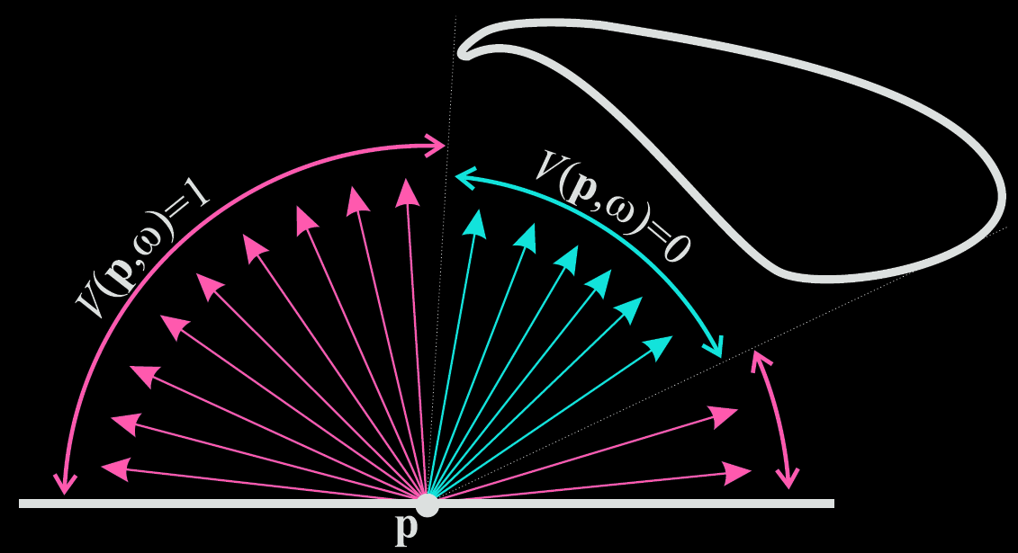
Ambient occlusion

Slide 43

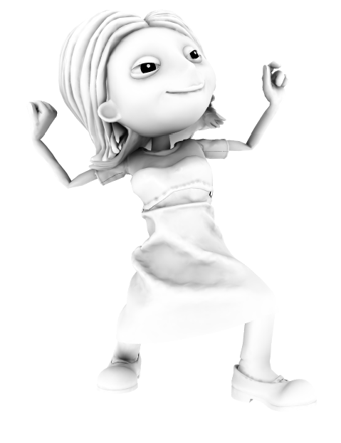
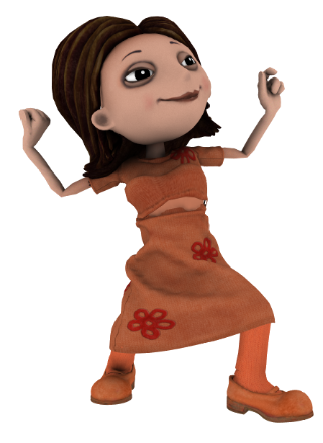
Ambient occlusion
x
=

Slide 44
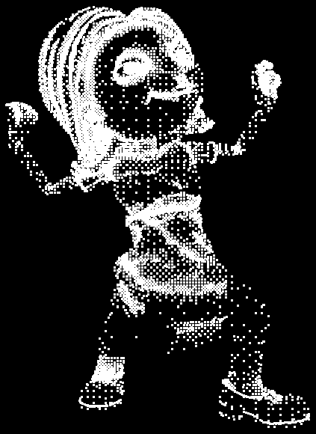
Ambient occlusion caching

Slide 45
Conclusion
Fast indirect illumination of diffuse surfaces
Sparse sampling & fast interpolation
Biased
Not consistent
Tons of implementation details that I did not discuss here

Slide 46
Further reading
Practical Global Illumination with Irradiance Caching
SIGGRAPH Course: 2008, Křivánek et al.
Book, 2009, Křivánek & Gautron
Both give references to further resources

Slide 47
Point-based Global Illumination

Slide 48
Point-based global illumination
Original idea
M. Bunnell, “Dynamic ambient occlusion and indirect lighting”, GPU Gems 2
Application in movie production
P. Christensen, “Point-based approximate color bleeding”, Pixar tech memo #08-01
Real-time implementation (CUDA)
T. Ritschel et al, “Micro-rendering for scalable, parallel final gathering”, SIGGRAPH Asia 2009

Slide 49
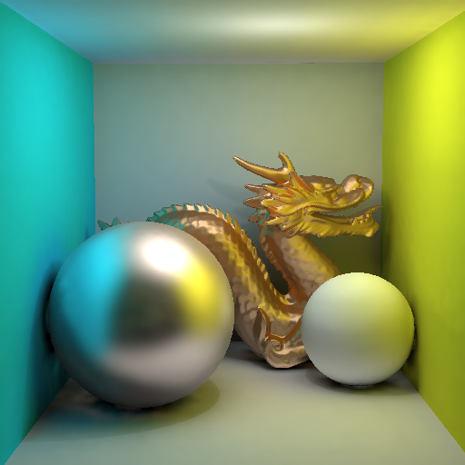
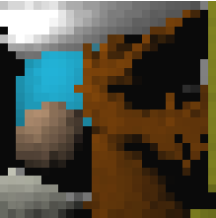
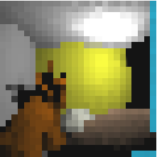
Point-based global illumination
Slide credit: Tobias Ritschel

Slide 50


Point-based global illumination
Slide credit: Per Christensen

Slide 51
References
Křivánek et al.: Global Illumination Across Industries, SIGGRAPH 2010 course. http://cgg.mff.cuni.cz/~jaroslav/gicourse2010/
Point-based Global Illumination for Film Production (Per Christensen, PIXAR)
Ray Tracing vs. Point-based GI for Animated Films (Eric Tabellion, PDI Dreamworks)
Ritschel et al. Microrendering for Scalable, Parallel Final Gathering, SIGGRAPH Asia 2009. http://www.mpi-nf.mpg.de/~ritschel/Microrendering/

Slide 52
References
Křivánek et al.: Global Illumination Across Industries, SIGGRAPH 2010 course. http://cgg.mff.cuni.cz/~jaroslav/gicourse2010/
Ray Tracing Solution in Film Production Rendering (Marcos Fajardo, SolidAngle)

Slide 53
What did we not cover?

Slide 54
In fact, many things…
Metropolis Light Transport
Virtual point lights / Many-light methods
Precomputed radiance transfer
Participating media + subsurface scattering
Real-time GI
Hair rendering
Appearance measurement and modeling

Slide 55

Metropolis Light Transport
(a) Bidirectional path tracing with 40 samples per pixel.
Image credit: Eric Veach

Slide 56

Metropolis Light Transport
(b) Metropolis light transport with an average of 250 mutations per pixel [the same computation time as (a)].
Image credit: Eric Veach

Slide 57

Metropolis Photon Tracing
Image credit: Toshiya Hachisuka

Slide 58
Instant radiosity (VPL rendering)
[Keller 1997]
Approximate indirect illumination by
Virtual Point Lights (VPLs)
Generate VPLs
Render with VPLs

Slide 59


Precomputed radiance transfer

Slide 60

Participating media

Slide 61






Subsurface scattering
Real
Simulated

Slide 62
Real-time GI
VPL methods
Screen-space methods
Cone-tracing (Unreal Engine)
Light propagation volumes (CryEngine)

Slide 63

Hair rendering

Slide 64


Appearance modeling

Slide 65
Conclusion

Slide 66

Research challenges in rendering
Existing algorithms are inherently bad for some practical scenes
More work to do for rendering researchers

Slide 67
What else in CG
Main general CG conferences
SIGGRAPH (ACM Transactions on Graphics – TOG)
SIGGRAPH Asia (ACM TOG)
Eurographics (Computer Graphics Forum)
http://kesen.realtimerendering.com/

Slide 68
What else in CG
Computational photography
Appearance modeling & capture
Animation (& capture)
Dynamic simulation (hair, cloth, water, smoke, solids…)
Visual perception
Natural phenomena
Non-photorealistic rendering
Sound simulation
Display technology
Interaction technology
Geometry modeling

Slide 69
General challenges in CG
Making CG usable: UI design, collaboration
Robust and efficient lighting simulation
Virtual human
Hair modeling
Animation
Cloth
Managing complexity
Natural environments etc
Virtual Worlds (shared 3D graphics)
…and more (the above is my random choice of “grand challenges”)

